Slide 1
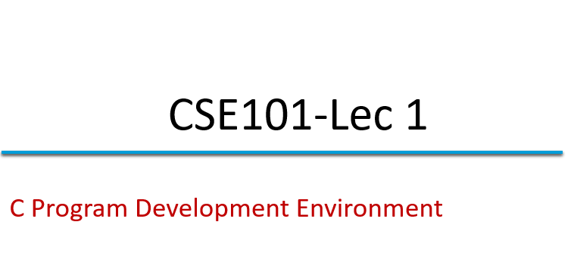

Slide 2
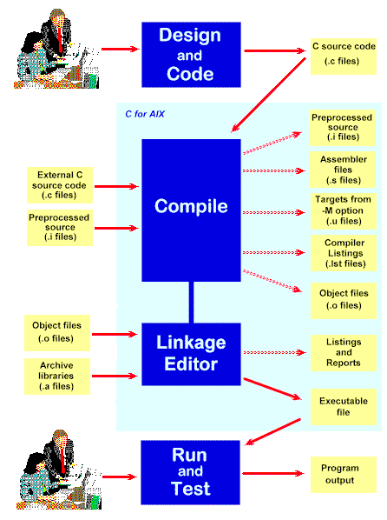
C Program Development Environment
A C program must go through various phases such as:
Creating a program with editor
Execution of preprocessor program
Compilation
Linking
Loading
Executing

Slide 3
Editor
Program is created in
the editor and stored
on disk.
Disk
Preprocessor
Disk
Preprocessor program
processes the code.
Compiler creates
object code and stores
it on disk.
Compiler
Disk
Linker links the object
code with the libraries,
Linker
Disk
Primary Memory
Loader
Loader puts program in memory.
Disk
.
.
.
.
.
.
Primary Memory
CPU
CPU takes each
instruction and
executes it, possibly
storing new data
values as the program
executes.
.
.
.
.
.
.

Slide 4
C Program Development Environment(cont.)
Phase 1: Create your program with an editor program
Phase 2: A preprocessor find some preprocessor directives (#include <stdio.h>) to include other files.
Phase 3: Compiler compiles the program into machine languages
Phase 4: A linker links the object code with the code in library or other places to produce an executable image.
Phase 5: A loader loads the executable image into memory (RAM).
Phase 6: CPU executes the program one instruction at a time. The load process in Windows OS is just input the name of the executable file.

Slide 5
MCQ
C programs are converted into machine language with the help of
An editor
A compiler
An operating system
An interpreter

Slide 6
Next Class: Program structure of C program. Various programming tools like flow chart and algorithms.

